Slide 1
Estimating changes in species interactions & community stability in a kelp forest ecosystem
Mark Scheuerell
NOAA Northwest Fisheries Science Center
Eric Ward
NOAA Northwest Fisheries Science Center
Steve Katz
Washington State University
@mark_scheuerell
#ISEC2016

Slide 2
Acknowledgments
United States taxpayers
Eli Holmes, Jim Thorson, Eric Buhle
Lots of other students, post-docs & unsuspecting colleagues

Slide 3
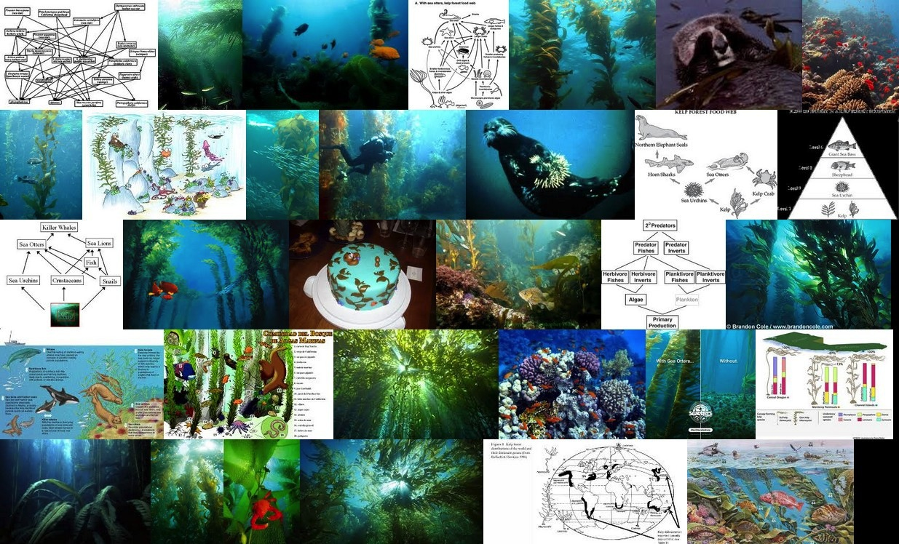
Kelp forest ecosystems
Images courtesy of Google & ImageQuilts
Notes:
Kelp forest ecosystems occur globally along temperate-zone coast lines, and are some of the most diverse and productive ecosystems of the world. They also provide a wide array of ecosystem services that have sustained human communities for millenia. Kelp forest ecosystems have also been the subject of many ecological studies examining the structure and function of food web dynamics.

Slide 4
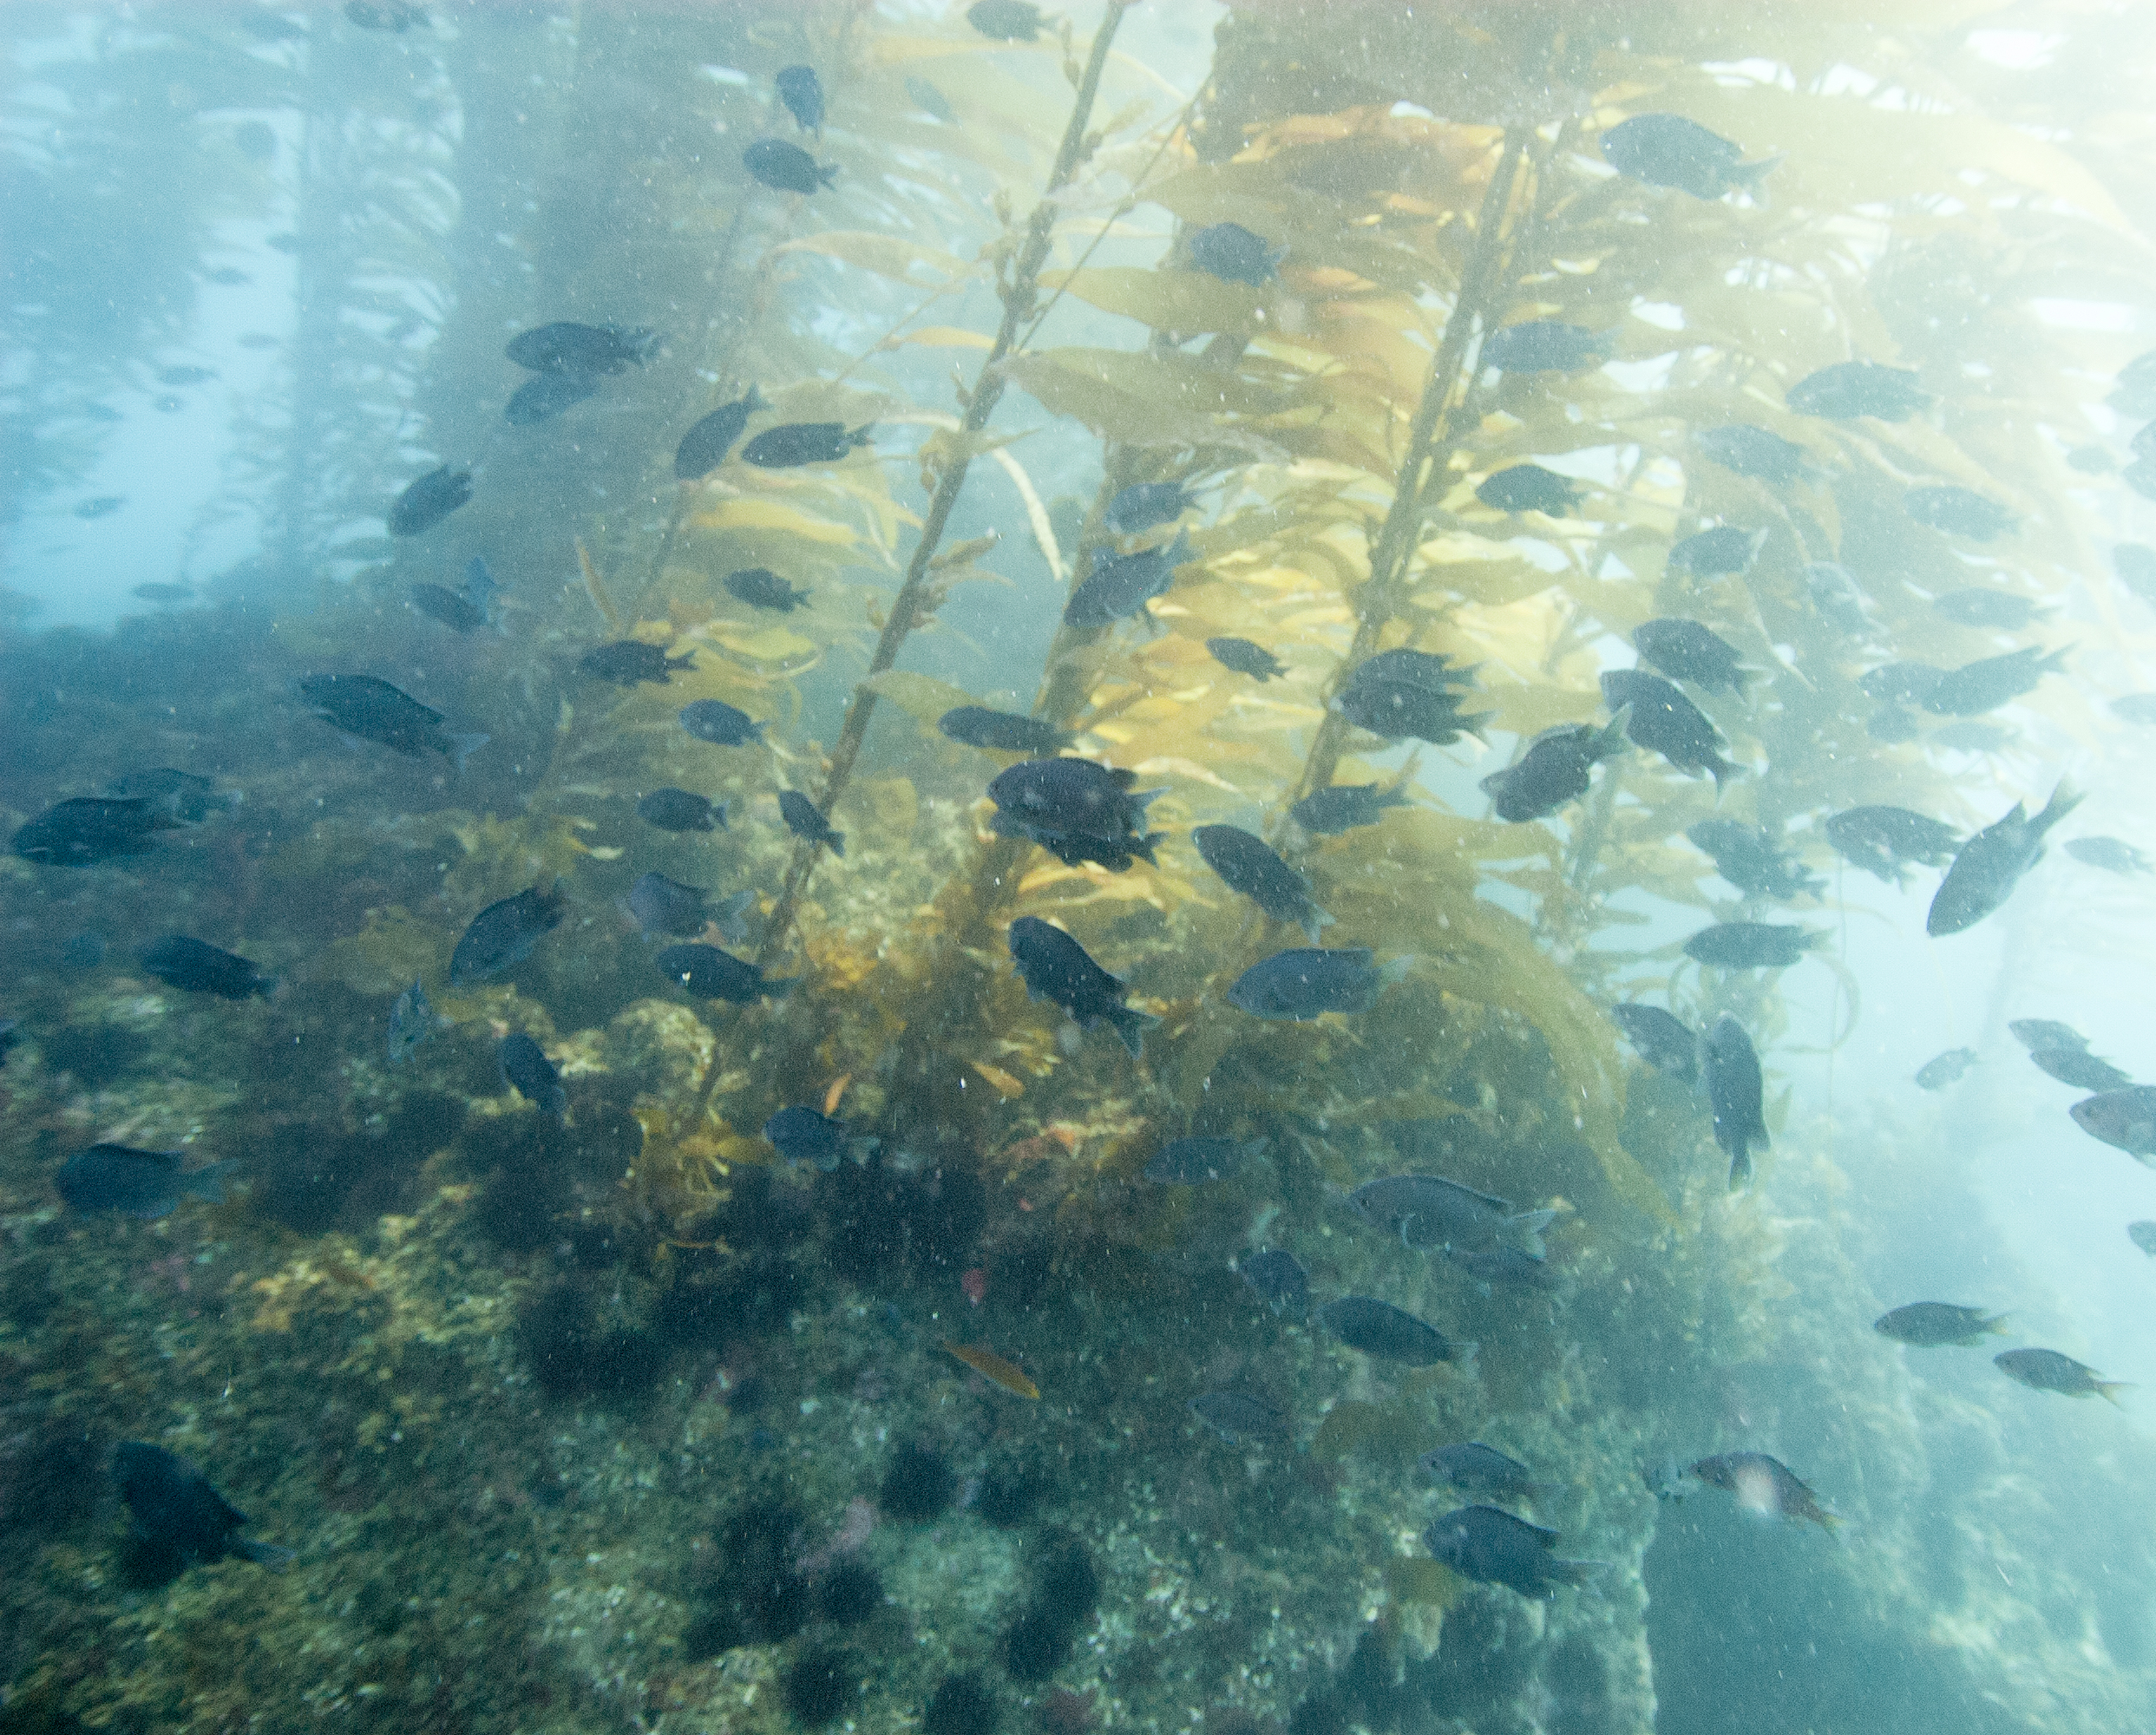
Conventional wisdom
Otters
Urchins
Kelps

Slide 5
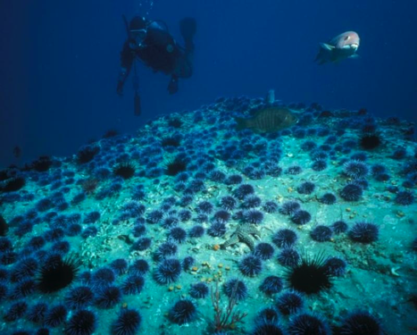
Conventional wisdom
Otters
Urchins
Urchins
Kelps
Kelps
Images courtesy of R Schwemmer & NPS

Slide 6
Questions about the larger community
Fish-eaters
1) How do community interactions change over time?
Otters
Invert- eaters
2) How does stability change over time?
Invert grazers
Herb. fish
3) How does stability relate to external forcing?
Kelps

Slide 7
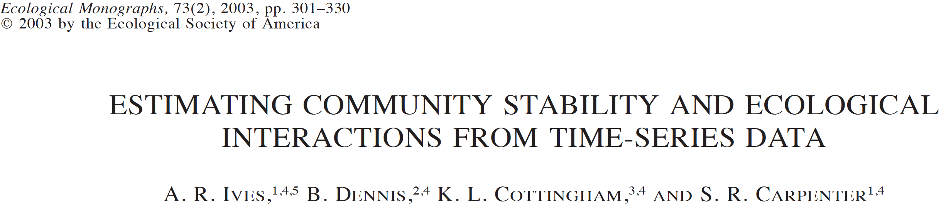
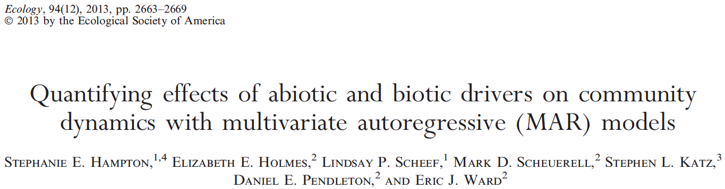
Community interactions from time series

Slide 8
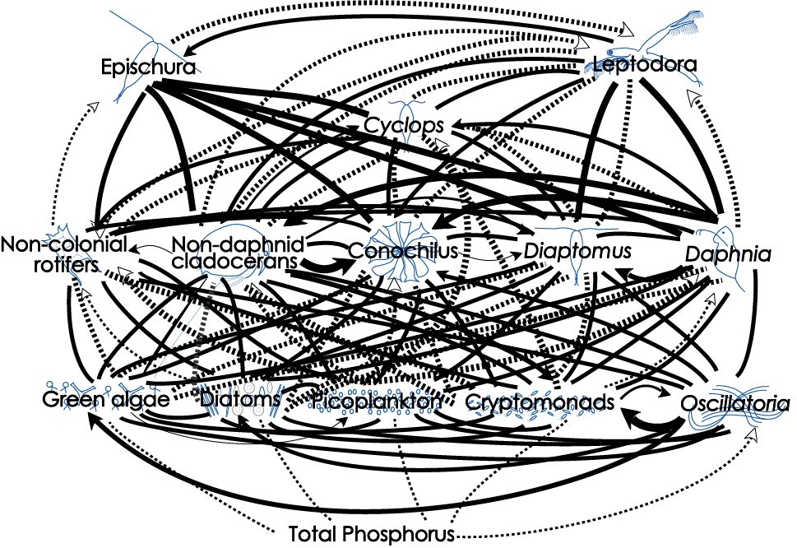
What is really going on here?
Lake Washington plankton community
Hampton, Scheuerell & Schindler (2006) Limnol Oceanogr

Slide 9
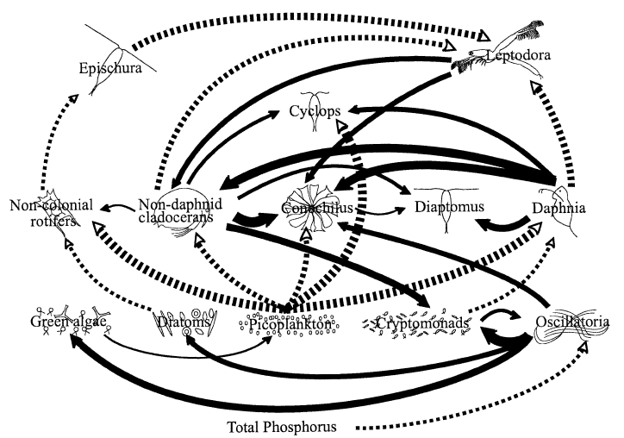
Identifying important players
Lake Washington plankton community
Hampton, Scheuerell & Schindler (2006) Limnol Oceanogr

Slide 10
Community model in matrix form
Ives et al (2003) Ecology

Slide 11
Community model in matrix form
Intrinsic
growth rates
Covariate
effects
log densities
Environmental
variation
Interactions
strengths
Covariates
Ives et al (2003) Ecology

Slide 12
Two issues with this model
1) This describes a process with no sampling or observation error
2) The community interactions don’t vary with time

Slide 13
State-space model
State equation
Observation equation

Slide 14
State-space model
State equation
Observation equation

Slide 15
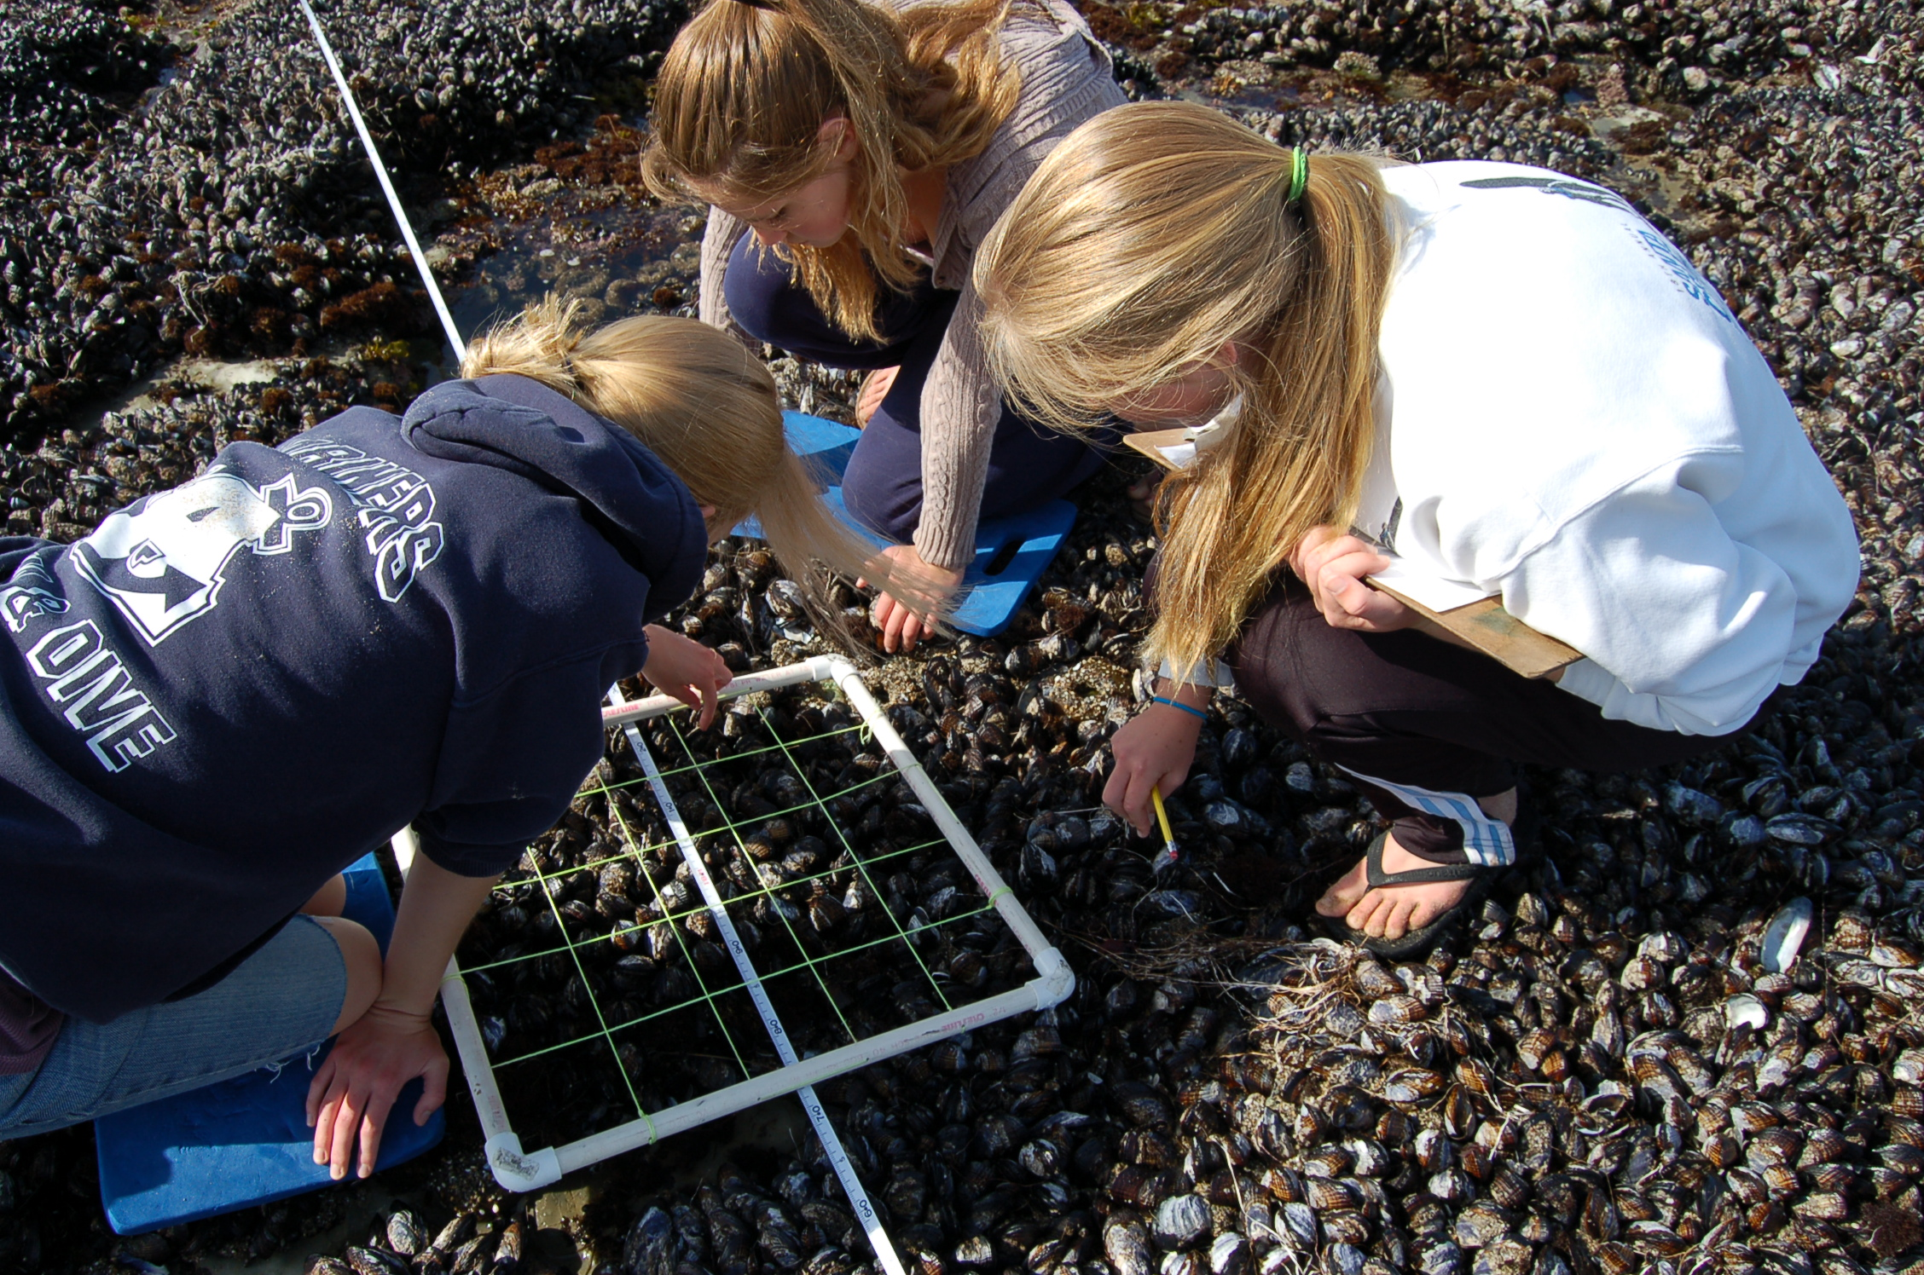
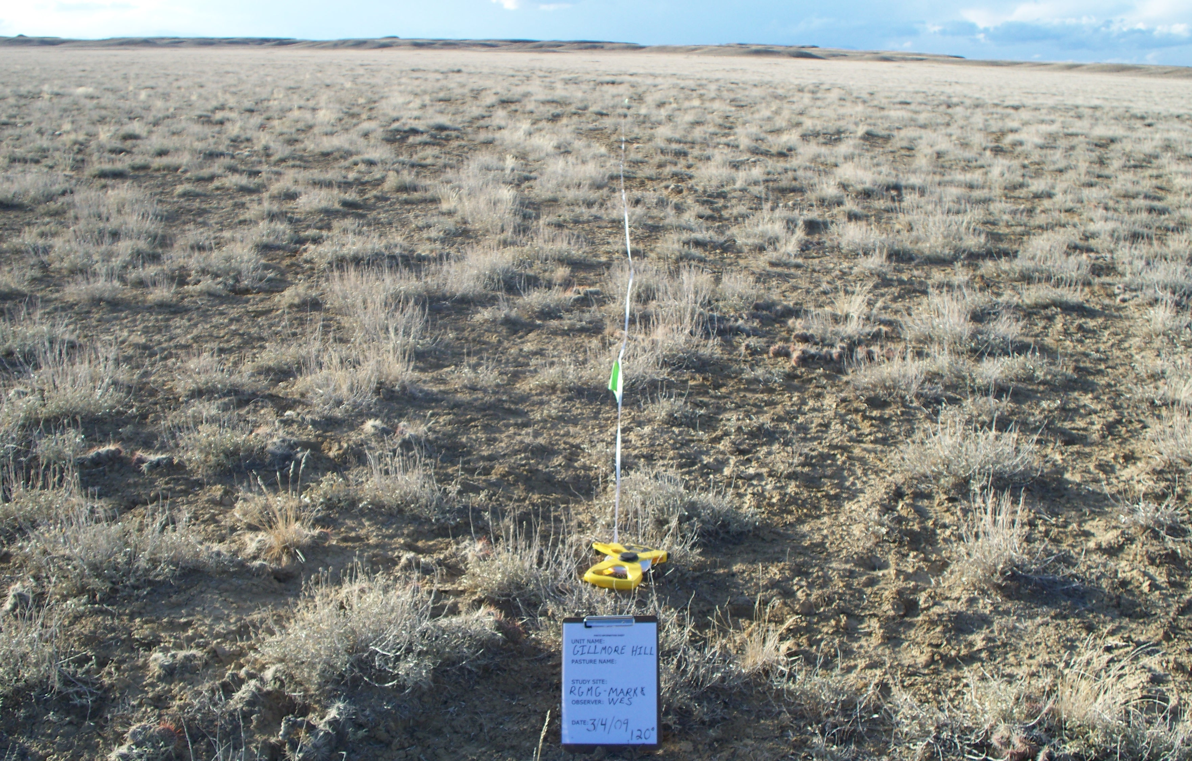
Count data are the basis for many studies
© KQED
log(0) = -Inf (!)
© NW College of Agriculture

Slide 16
Allowing for count data
Observation of guild g at location i at time t
State

Slide 17
Time-varying interactions
State equation

Slide 18
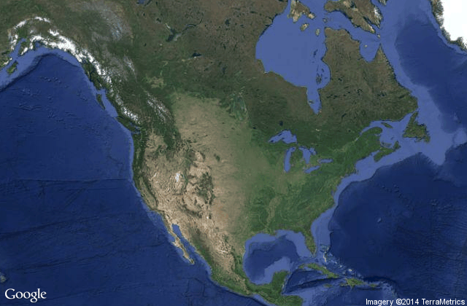
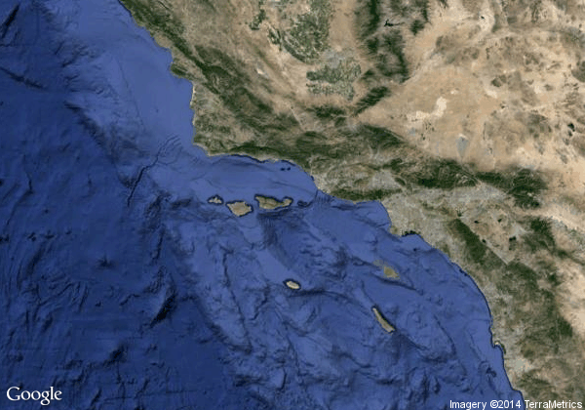
Kelp forests in southern California
Los Angeles
San Nicolas Island
Images courtesy of Google

Slide 19
Data for San Nicolas Island
Kenner et al (2013) A multi-decade time series of kelp forest community structure at San Nicolas Island, California (USA). Ecology 94:2654
7 sites around the island
Biannual surveys from 1980-2011 (n = 63)
Divers collect data on:
Fish (59 spp)
Inverts (14 spp)
Kelps (6 spp)
Image courtesy of Google

Slide 20
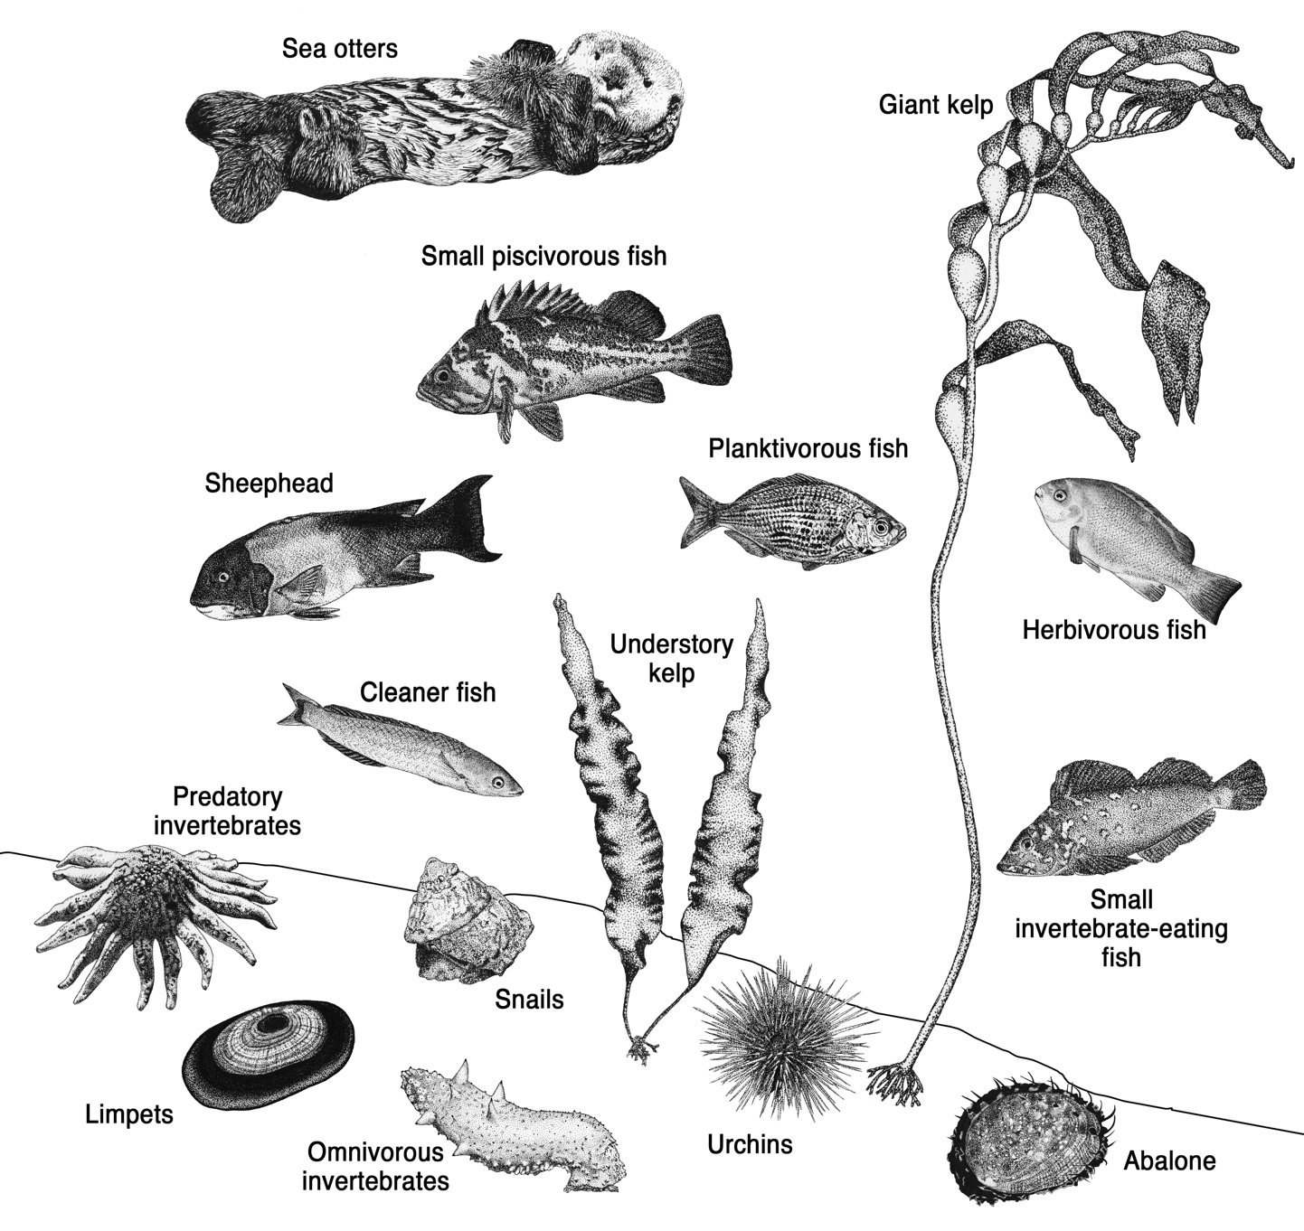
Kelp forest
community
at San Nic
Artwork by Shannon Hennessey

Slide 21
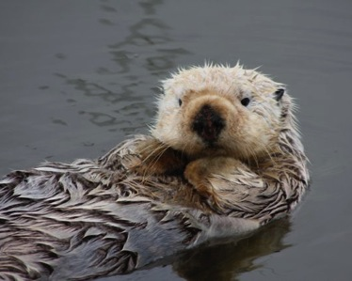
Sea otters at San Nicolas
Otters absent for >100 yr prior to 1987
Image courtesy of Steve Lonhart

Slide 22
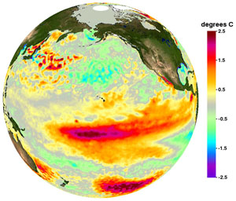
El Niño around San Nicolas
Image courtesy of NOAA

Slide 23
Urchin harvest at San Nicolas
Data from Calif Dept Fish Wildlife

Slide 24
Fitting the model
6 observations of 4 states
Each state has same
MCMC via JAGS

Slide 25
Changes in density & density-dependence

Slide 26
Examples of trophic effects
Top-down
Bottom-up

